Slide 1
Standardization
Gowtham K Jayachandiran

Slide 2
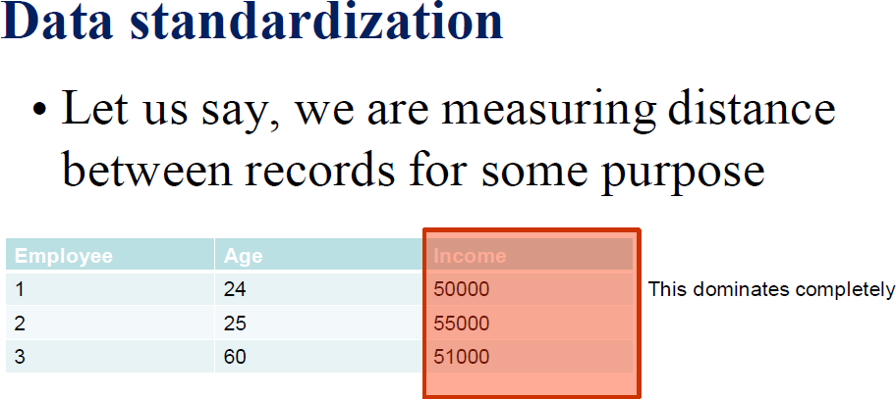

Slide 3
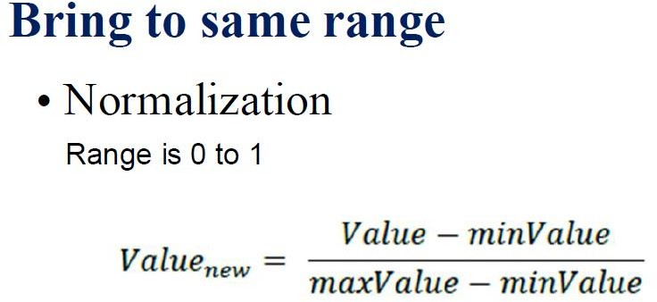

Slide 4
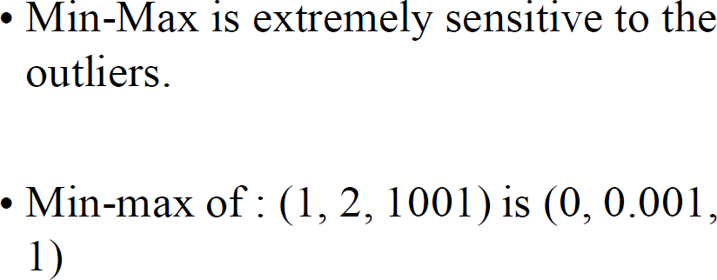

Slide 5
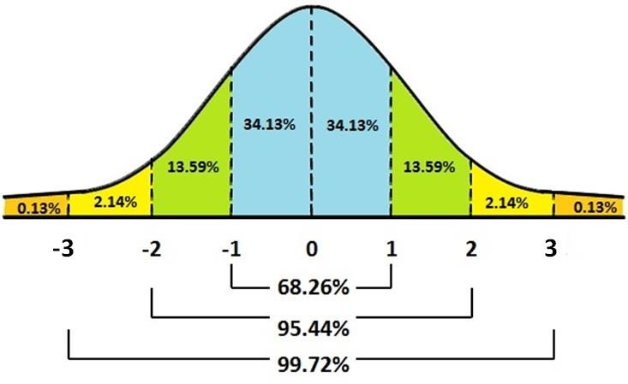
Standardization

Slide 6


Standardization Formula

